Slide 1


A Purposeful Walk Down Wallstreet
Michael Shields, Nabeel Asghar, Shojib Miah, Michael Chen

Slide 2
Features/Functionality
What we have completed:
Implemented 3 prediction functions using macroeconomic variables
Fetching macroeconomic data from different data sources
Implemented automated percent error and trend accuracy testing
Implemented automatic production of weighting for functions
Implemented automated testing of test cases
2

Slide 3
Missing Features
DHL Barometer – Measures the amount of trading between each country
There was no free or reliable way to obtain this data
Prediction for 2 years into the future to compare to new algorithms
Not enough time to implement
3

Slide 4
What we had planned for the Final Application
Improve back testing to test algorithms over decades
Plot forecasted dates from past to compare to actual close price
Rework MSF1 function
Implement Student’s t-test
Improve MSF2 and MSF3 accuracy
Execute Test Cases
4

Slide 5
Final Application Accomplishments
We have completed:
We improved back testing to test algorithms over different time periods
Plot and compare past forecasted dates against actual closing prices
Reworked MSF1 and improved accuracy
Implemented Student’s t-test on new algorithms
Cut percent error of MSF2 and MSF3 by half
Implemented automatic testing and executed test cases
5

Slide 6
Algorithm Trend Accuracy
Stock | ARIMA | PRICE PRED | Random Forest | SVM | XGB | MSF1 | MSF2 | MSF3
GM | 91.72% | 50.00% | 49.27% | 49.01% | 49.60% | 50.00% | 62.50% | 62.50%
PFE | 93.05% | 48.34% | 48.87% | 48.54% | 46.56% | 37.50% | 12.50% | 50.00%
SPY | 92.71% | 47.28% | 48.81% | 47.95% | 49.60% | 12.50% | 75.00% | 75.00%
XPH | 94.17% | 50.07% | 50.13% | 50.60% | 50.99% | 37.50% | 75.00% | 62.50%
CARZ | 91.58% | 49.14% | 47.48% | 48.94% | 49.14% | 50.00% | 62.50% | 75.00%
^TYX | 93.19% | 47.36% | 48.30% | 31.91% | 49.13% | 50.00% | 25.00% | 50.00%
Average | 92.74% | 48.70% | 48.81% | 46.16% | 49.13% | 39.58% | 52.08% | 62.50%
6

Slide 7
Old Algorithms Average Percent Error Accuracy
Stock | ARIMA | PRICE PRED | Random Forest | SVM | XGB
GM | 0.51% | 1.71% | 1.07% | 2.81% | 2.40%
PFE | 0.16% | 0.46% | 0.58% | 1.94% | 2.36%
SPY | 0.23% | 0.51% | 0.49% | 1.31% | 2.05%
XPH | 0.48% | 0.85% | 0.85% | 3.21% | 2.37%
CARZ | 0.42% | 1.12% | 0.37% | 1.19% | 1.37%
^TYX | 0.43% | 1.64% | 0.72% | 2.05% | 1.16%
Average | .37% | 1.05% | .68% | 2.09% | 1.95%
We compare closing prices for each quarter to forecasted prices generated from 2018-2020 using the six machine learning algorithms and 8 Total Points of Data
7

Slide 8
New Algorithms Average Percent Error Accuracy
OLD | MSF2 | MSF3
GM | 9.72% | 9.25%
PFE | 13.14% | 13.48%
SPY | 16.46% | 16.86%
XPH | 5.86% | 5.88%
CARZ | 11.15% | 10.76%
^TYX | 11.12% | 14.19%
Average | 11.24% | 11.74%
NEW | MSF2 | MSF3
GM | 4.69% | 4.63%
PFE | 6.67% | 7.77%
SPY | 1.99% | 3.08%
XPH | 6.32% | 5.94%
CARZ | 2.87% | 3.07%
^TYX | 7.31% | 6.71%
Average | 4.98% | 5.2%
We compare closing prices for each quarter to forecasted prices generated from 2018-2020 using the MSF2 and MSF3 formulas
8 Total Points of Data
8

Slide 9
MSF1 Rework
MSF1 Before
MSF1 After
forecastdate | forecast price | macroID | instrumentID | algorithmcode
2020-03-31 | 31.6085 | 1 | 1 | MSF1
2020-06-30 | 31.929 | 1 | 1 | MSF1
2020-09-30 | 32.2529 | 1 | 1 | MSF1
2020-12-31 | 32.58 | 1 | 1 | MSF1
2021-03-31 | 32.9104 | 1 | 1 | MSF1
2021-06-30 | 33.2442 | 1 | 1 | MSF1
2021-09-30 | 33.5813 | 1 | 1 | MSF1
2021-12-31 | 33.9219 | 1 | 1 | MSF1
2022-03-31 | 34.2659 | 1 | 1 | MSF1
2020-03-31 | 31.1189 | 2 | 1 | MSF1
2020-06-30 | 30.9476 | 2 | 1 | MSF1
2020-09-30 | 30.7772 | 2 | 1 | MSF1
2020-12-31 | 30.6078 | 2 | 1 | MSF1
2021-03-31 | 30.4393 | 2 | 1 | MSF1
forecastdate | instrumentid | forecastcloseprice | algorithmcode
3/29/2018 | 1 | 40.86353261 | MSF1
6/29/2018 | 1 | 40.73806624 | MSF1
9/28/2018 | 1 | 40.61359404 | MSF1
12/31/2018 | 1 | 40.49010919 | MSF1
3/29/2019 | 1 | 40.36760492 | MSF1
6/28/2019 | 1 | 40.24607453 | MSF1
9/30/2019 | 1 | 40.12551135 | MSF1
12/31/2019 | 1 | 40.00590875 | MSF1
3/29/2018 | 2 | 36.1082496 | MSF1
6/29/2018 | 2 | 35.99738374 | MSF1
9/28/2018 | 2 | 35.88739634 | MSF1
12/31/2018 | 2 | 35.7782814 | MSF1
3/29/2019 | 2 | 35.67003294 | MSF1
6/28/2019 | 2 | 35.56264503 | MSF1
9

Slide 10
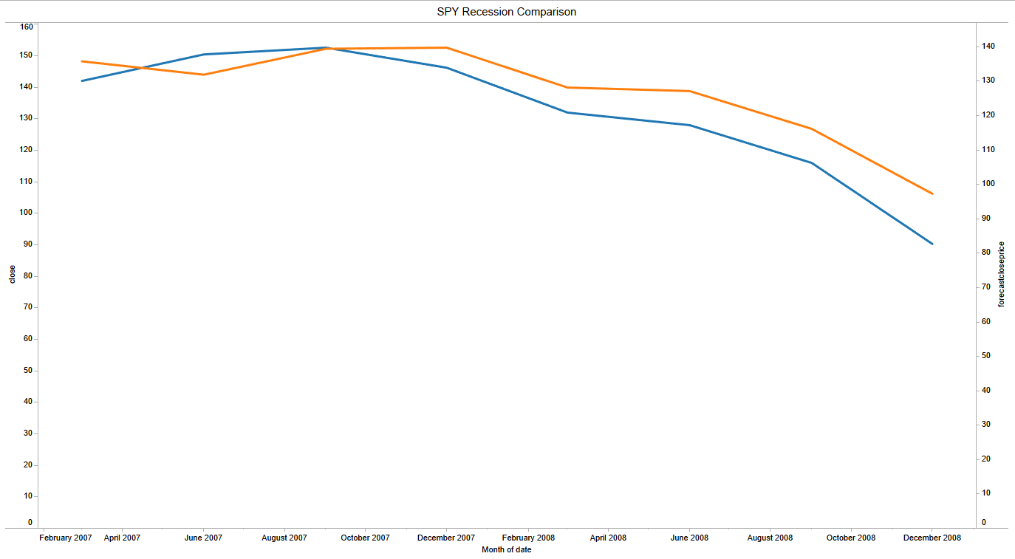

MSF2 Compared to 2008 Recession for SPY
10

Slide 11
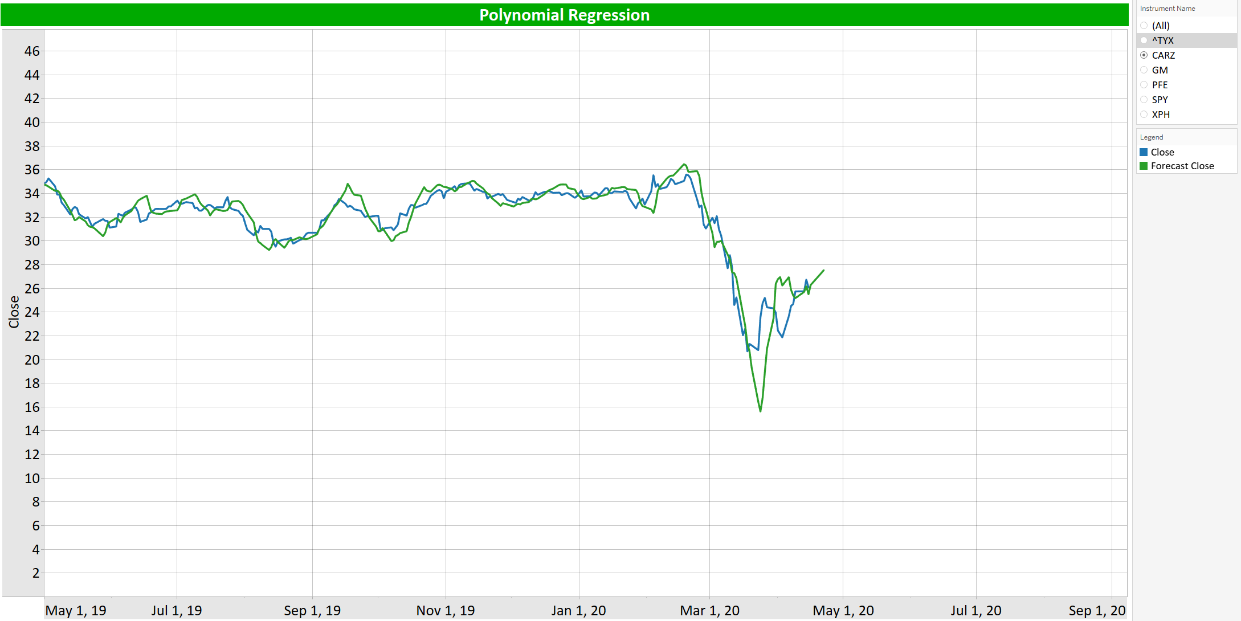
Polynomial Regression
11

Slide 12
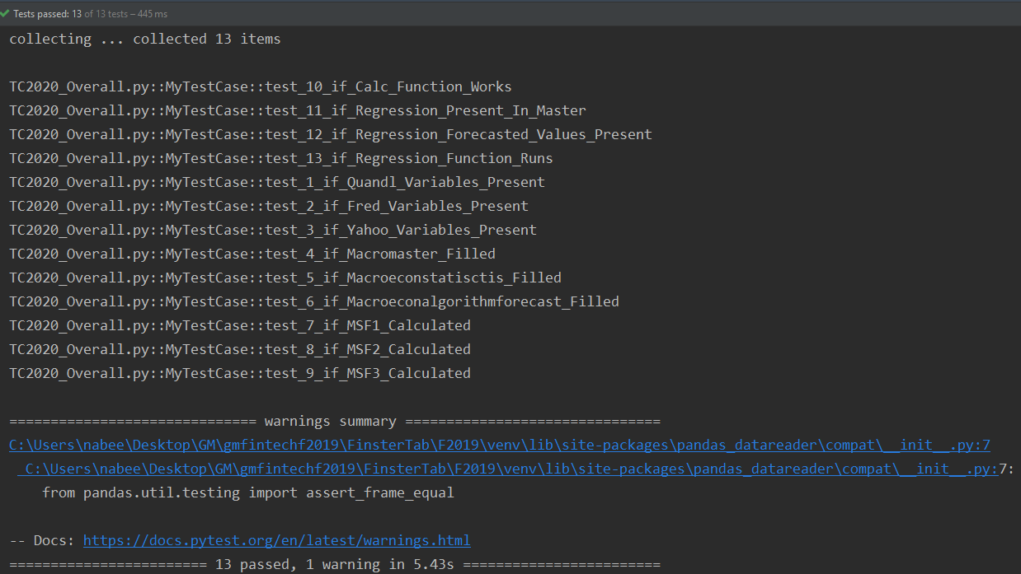
Automated Testing
Implemented a fully automated testing module.
12

Slide 13
The Demo
We will now take a look at the application itself
13

